Slide 1
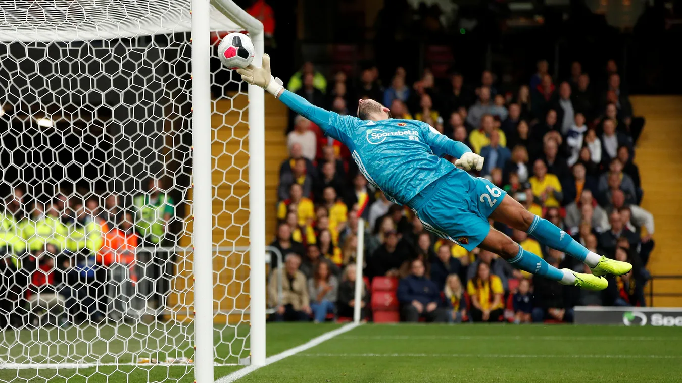
PREMIER LEAGUE PREDICTIVE ANALYSIS
September 2022

Slide 2





TEAM
Sam Caslowitz
- Machine Learning
Trevor Jackson
- Database
- Visualization
Parker Jones
- Visualization
Kwasi Sefah
- Machine Learning
- Visualization
Edwin Yu
- Machine Learning
- Visualization

Slide 3
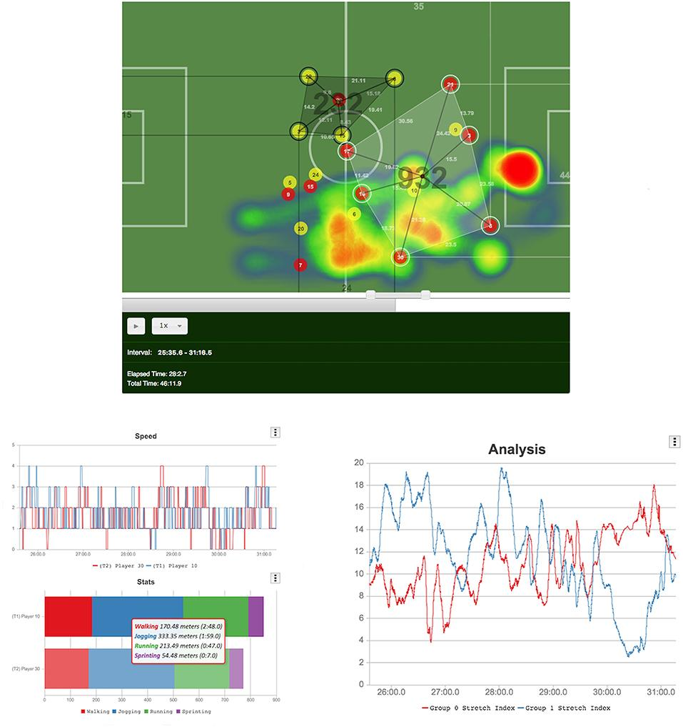
PROJECT OVERVIEW
Sports statistics and analytics has been increasingly popular across all sports as analytical tools have become more available and powerful.
Higher volumes and precision of data has become more readily available, but the dynamics of team sports has remained the same.
Our goal with this project is to use historical season data from the Premier League in English Football (or Soccer) to create predictive models that can influence team decision making.

Slide 4
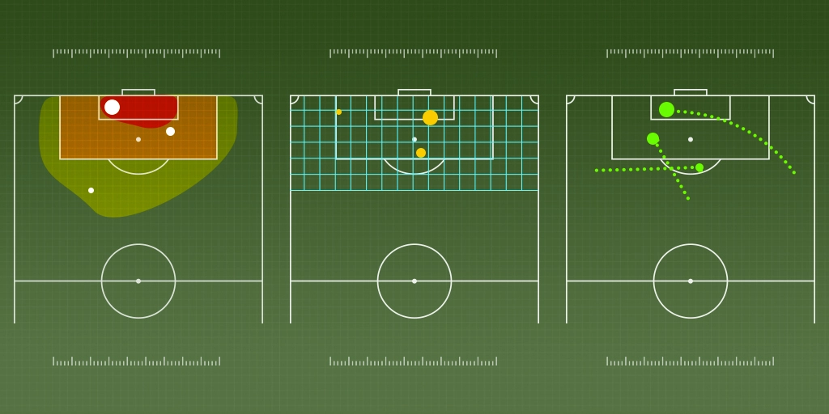
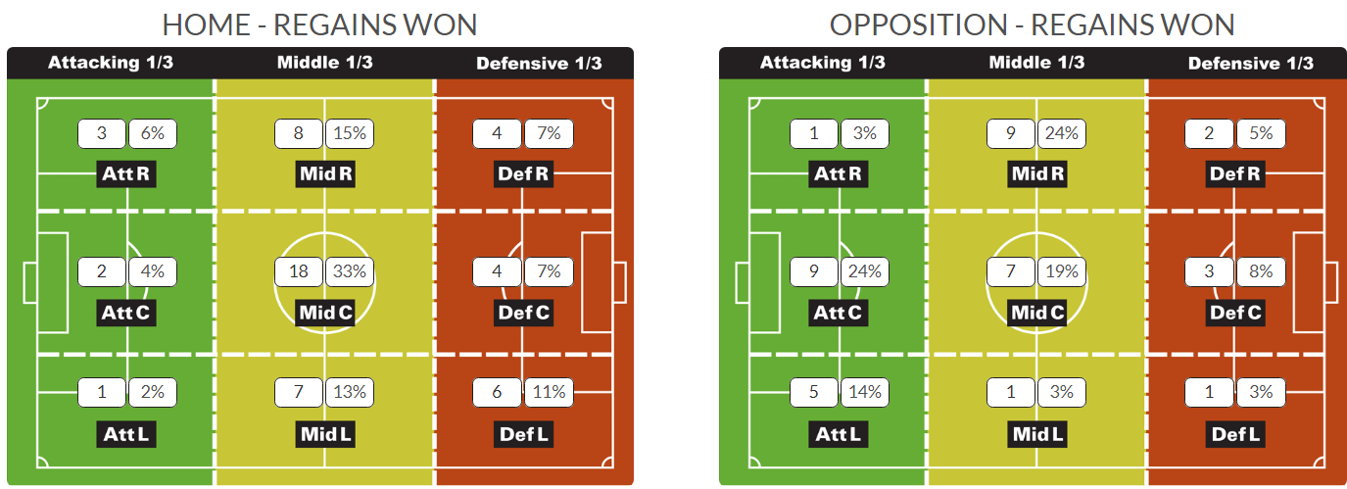
THESIS CAN WE LOOK AT THE PAST 5 YEARS OF PREMIER LEAGUE DATA AND PREDICT THIS YEAR’S RESULTS?
Ideas Worth Exploring
How does a red card affect the outcome of a game?
Is the home team advantage real?
Is it possible to predict the Ballon D’Or qualifiers?
Do larger contracts win more games?
Can individual players win the World Cup for their team?
What’s the most important variable in determining ticket sales?
How do age and experience affect scoring potential?

Slide 5
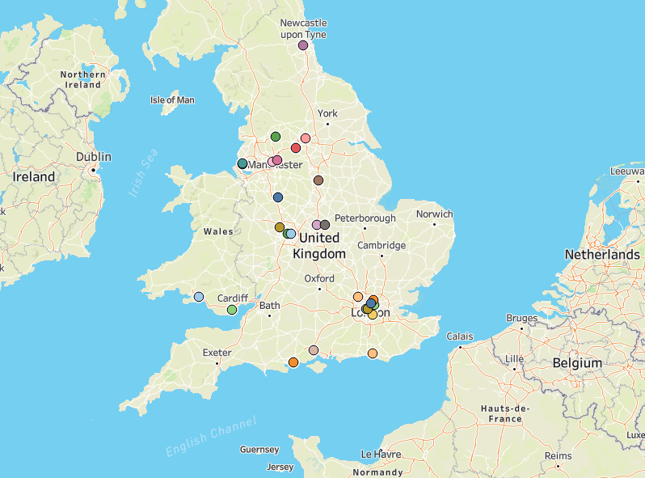
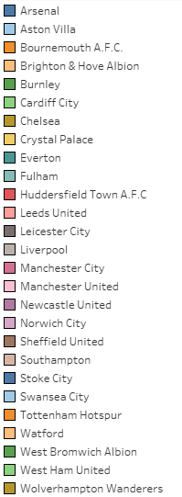
GEOGRAPHIC LOCATION OF TEAMS
PREMIER LEAGUE PREDICTIVE ANALYSIS

Slide 6
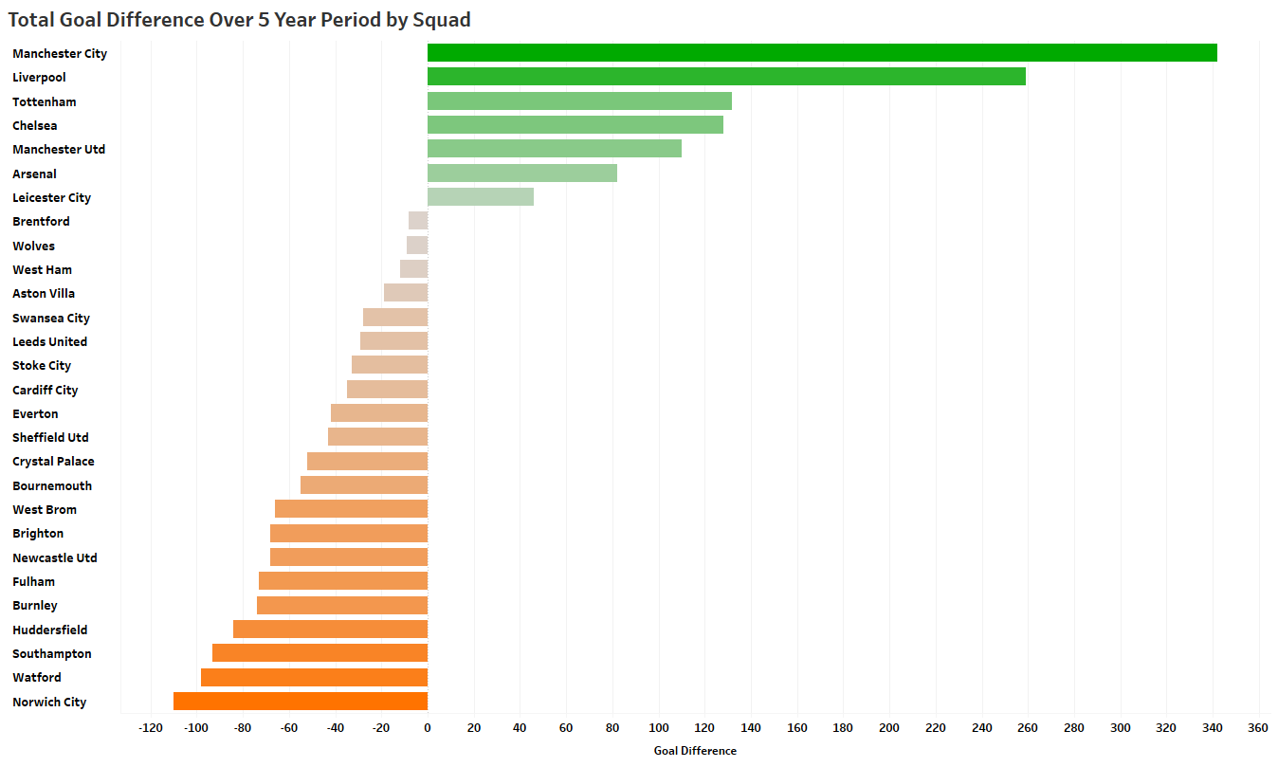
METRICS CONSIDERED
Total Wins/Losses
Clearance Off-Line
Home Wins/Losses/Draws
Away Wins/Losses/Draws
Goal Differential
Goals Scored/Goals For
Goals Allowed/Goals Against
Expected Goals
Expected Goals Against
Player Salary
Clean Sheets
Corners
Tools/Libraries Used
SQL
Pandas
Matplotlib
Tableau
statsmodels.api
sklearn library:
LinearRegression, datasets, minmaxscaler, rfe, accuracy_score, train_test_split, cross_val_score, RandomForestClassifier

Slide 7
PROJECT OBJECTIVES
The Model
Create a Linear Regression model based on the Premier League’s last five years’ worth of gameplay statistics. Ideally, this model will consider some of the previously mentioned metrics.
Then apply the Random Forest model to create a matrix of predicted results for the 2022 season. This should provide enough information to determine the expected league standings for each team.

Slide 8
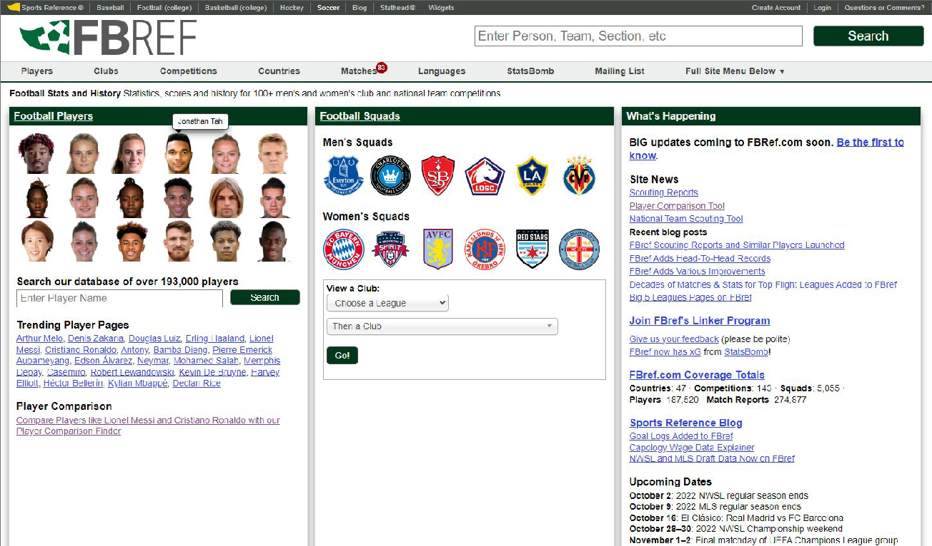
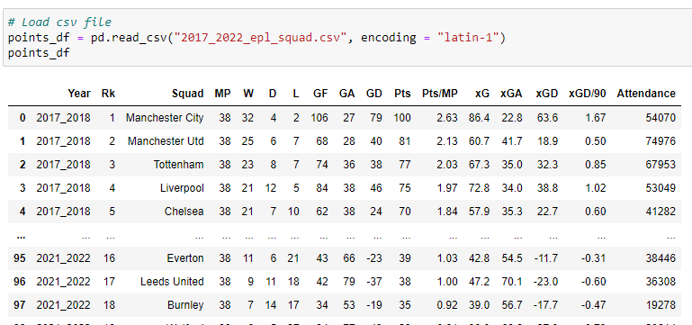
SOURCES AND DATABASE
Most of the data was pulled from the FBREF section of the sports statistic website Sports Reference.
The website can filter by various league, player, and team criteria; exported as a CSV file for easy analysis.
For the purposes of this project, the range of data used was for the seasons spanning 2017 to 2022.

Slide 9
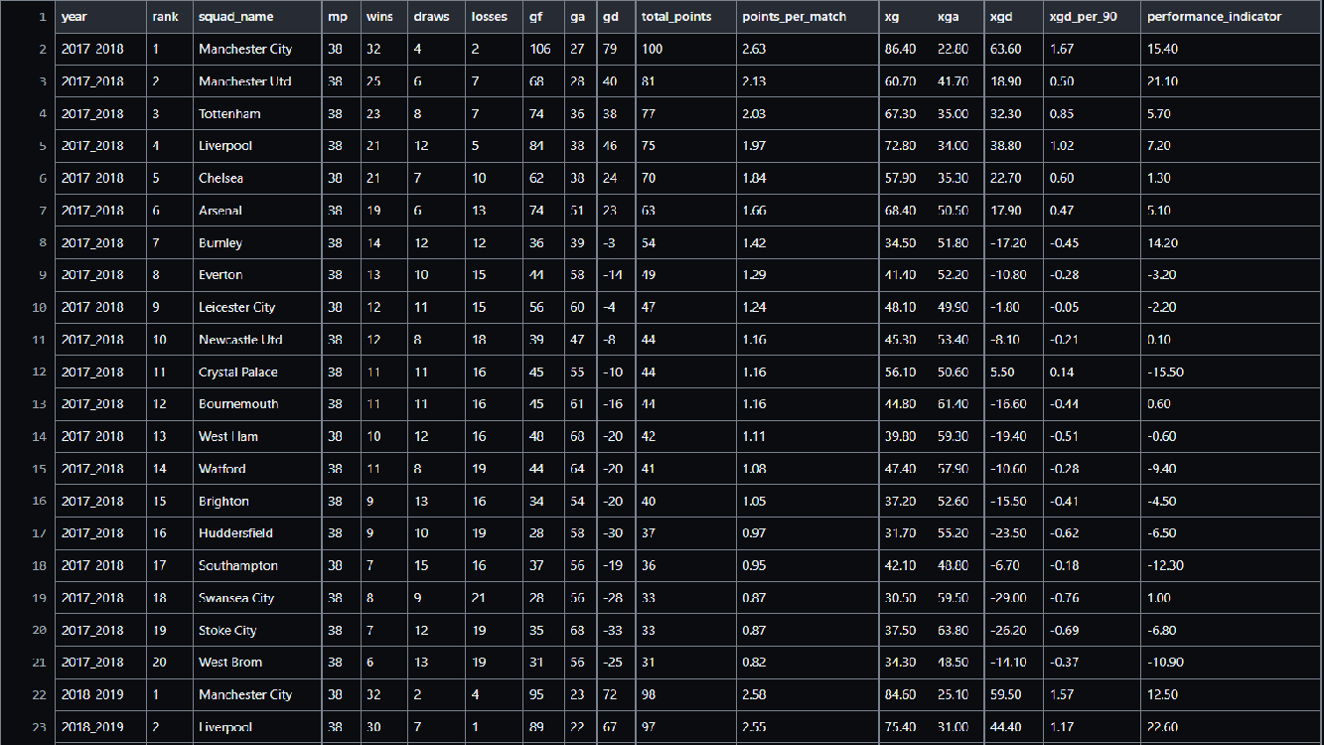

Slide 10
CLEANING, COLLATING, AND INTERPRETING
Clean CSV Files
Visualize Data
Linear Regression
Random Forest
Predictive Analysis
Remove any irrelevant information to make the files more manageable. Join relevant CSV files on common categories.
Graphically represent the data and observe. Take special note of any outliers, trends, or inconsistencies.
Once the data is well represented, perform linear regressions on various metrics to quantitatively define any significant observations.
Use the Random Forest module to create a best fit model mapped to our data points.
Create expected league standings based on the model. There are many dependent variables, so even minor adjustments can cause major shifts in the results.

Slide 11
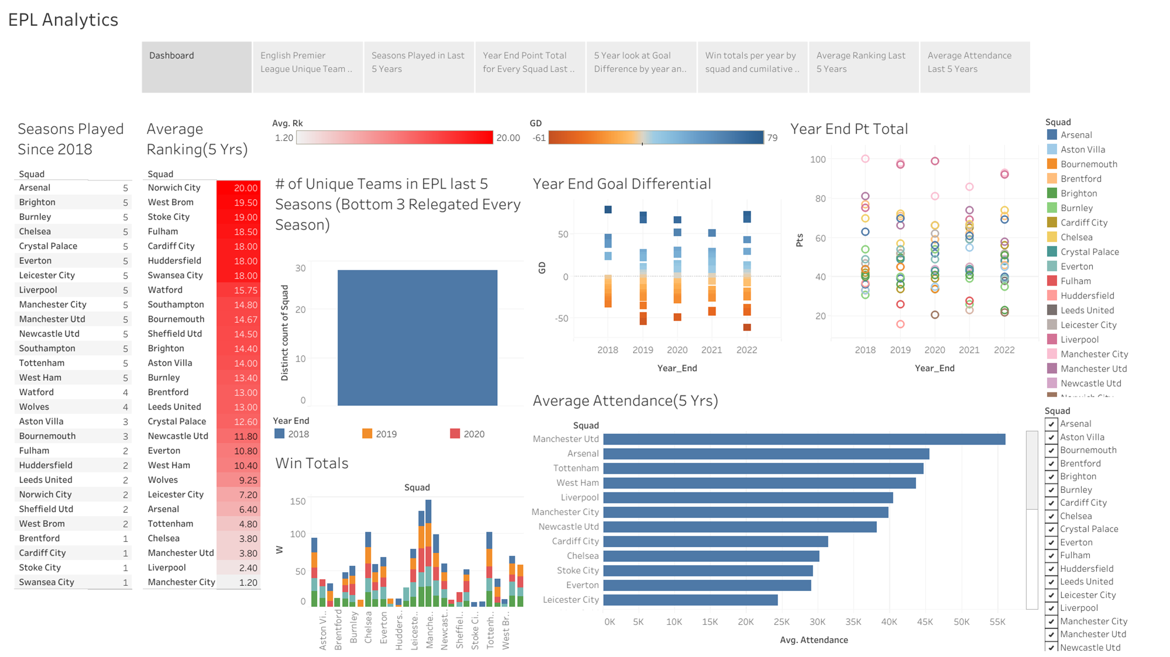

Slide 12
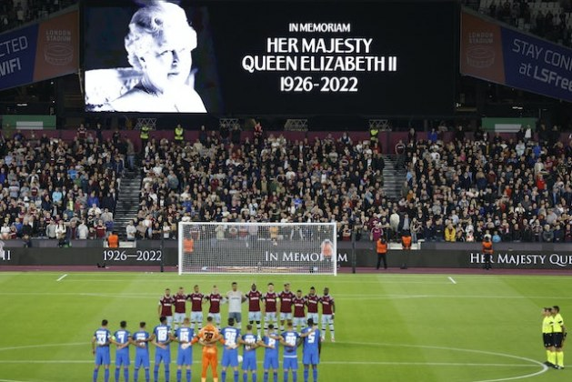
Machine Learning: Examining
Ranking using Linear Regression
- We examined the relationship between the ranking of each team with data gathered over the last 5 seasons from the EPL from FBref.com.
- We looked at Ranking versus Wins, Losses, Draws, Goals Allowed(GA), Goals For (GF), Goal Difference(GD), Expected Goals(xG), Expected Goals Allowed(xGA), and Attendance to find which variable have the strongest correlation to determining a championship winning soccer team based on the data we have.

Slide 13
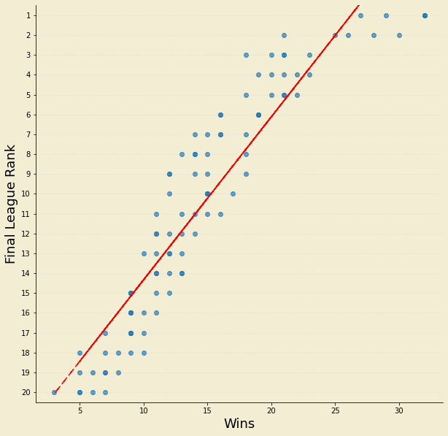
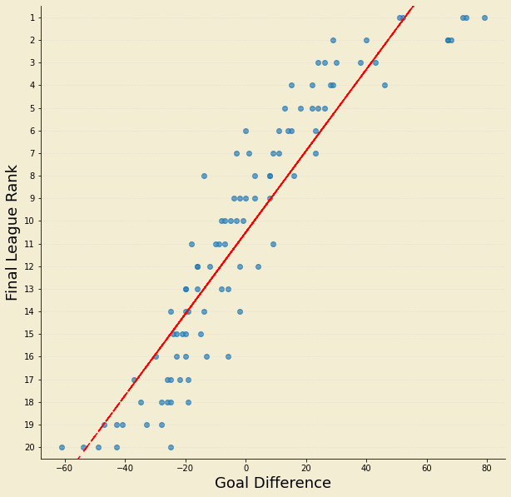
Linear Regression: Best Models vs Rank
Wins vs Rank. The correlation coefficient is 0.862099963778365
Goal Difference. The correlation coefficient is 0.8528223298536282.

Slide 14
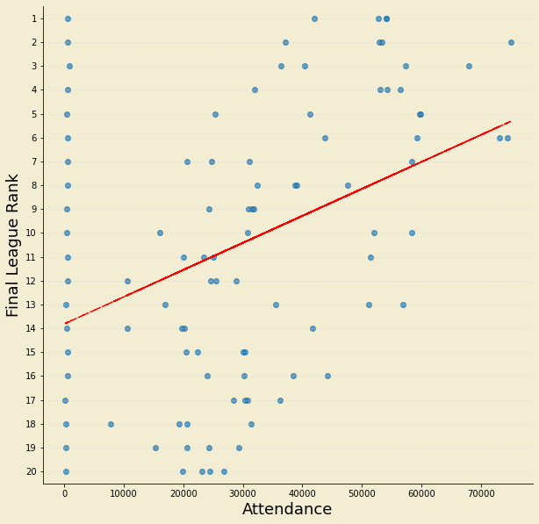
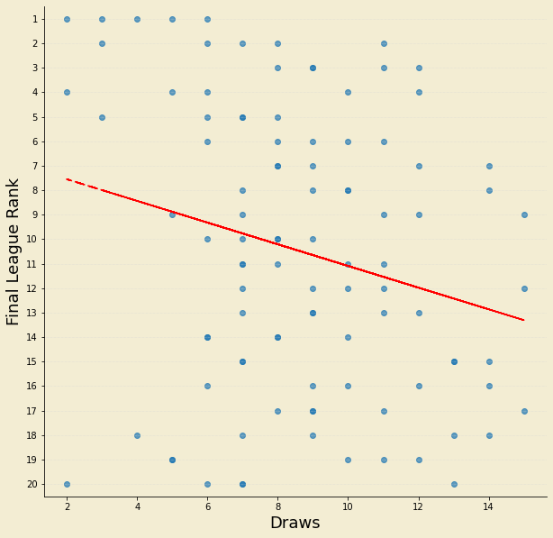
Linear Regression: Worst Performing vs Rank
Draws vs Rank. The correlation coefficient is 0.055343155643351016.
Attendance vs. Rank. The correlation coefficient is 0.15846314148638874.

Slide 15
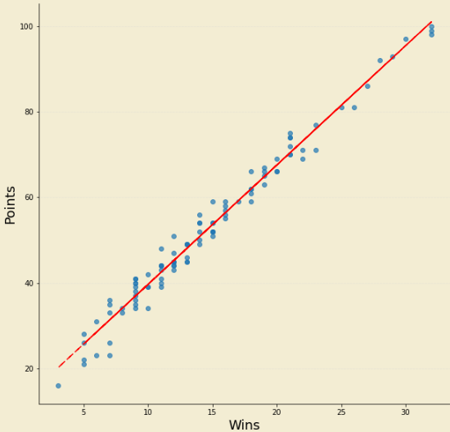
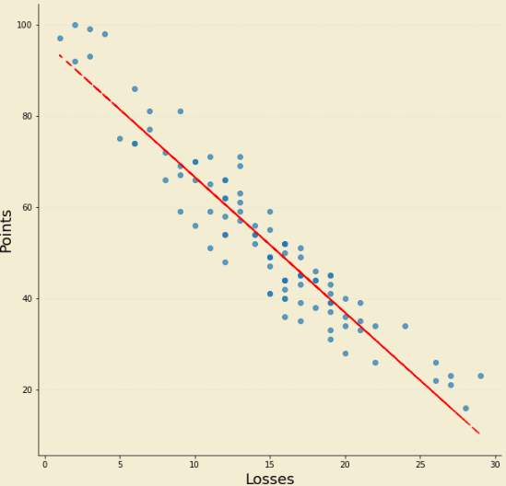
Relationship between Wins, Losses and Points

Slide 16
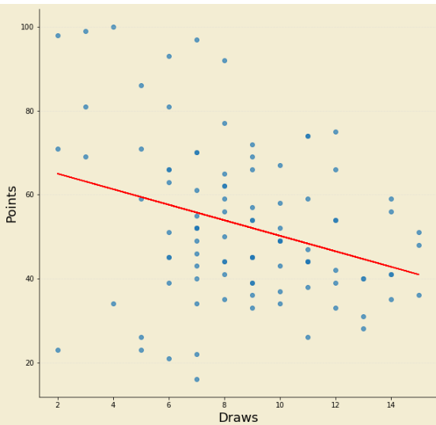
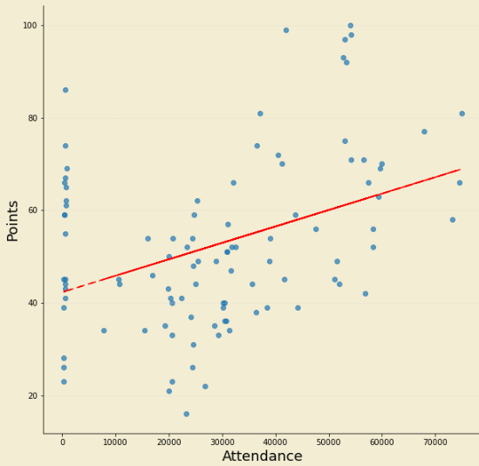
Relationship between Draws, Attendance and Points

Slide 17
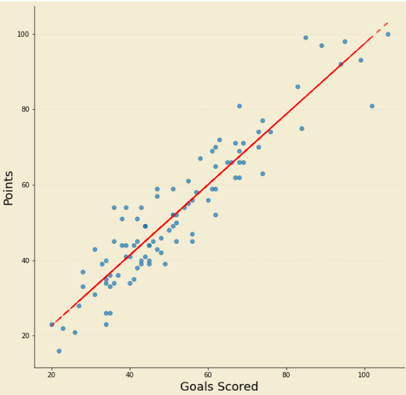
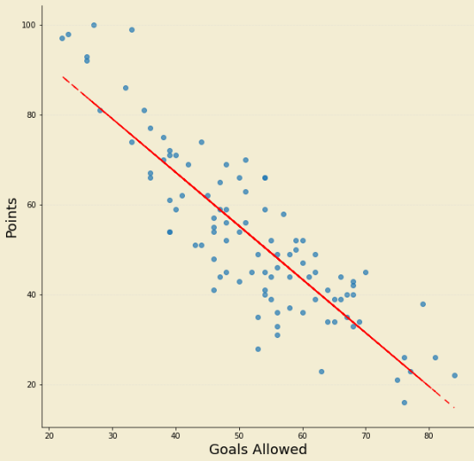
Relationship between Goals Scored, Goals Allowed and Points

Slide 18
RESULTS FROM THE MODEL
Wins and Points
Losses and Points
Draws and Points
Model coefficient - 2.80
Model intercept - 11.74
R-squared - 0.98
Model coefficient - (2.97)
Model intercept - 96.27
R-squared - 0.89
Model coefficient - (1.85)
Model intercept - 68.69
R-squared - 0.09

Slide 19
RESULTS FROM THE MODEL
Attendance and Points
Goals Scored and Points
Goals Allowed and Points
Model coefficient - 0.00
Model intercept - 42.29
R-squared - 0.15
Model coefficient - 0.93
Model intercept - 3.92
R-squared - 0.87
Model coefficient - (1.19)
Model intercept - 114.80
R-squared - 0.75

Slide 20
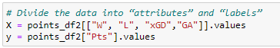
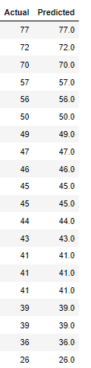
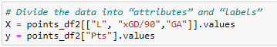
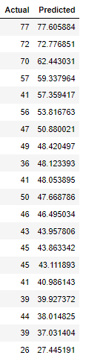
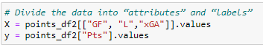
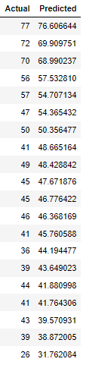
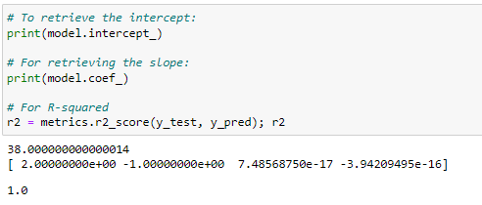
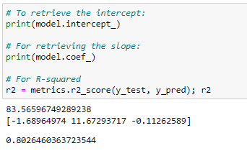
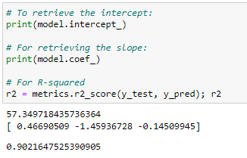
MULTIPLE LINEAR REGRESSION

Slide 21
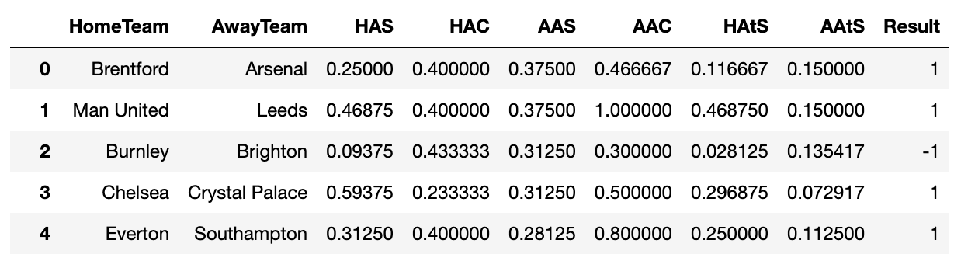
RANDOM FOREST
Focused on analyzing home and away performance to predict match outcomes.
Calculated the average goals scored, conceded, and the attacking strength for home and away.
Outcome of each game could be one of three results:
1 = Home team won
0 = Draw
-1 = Away team won

Slide 22
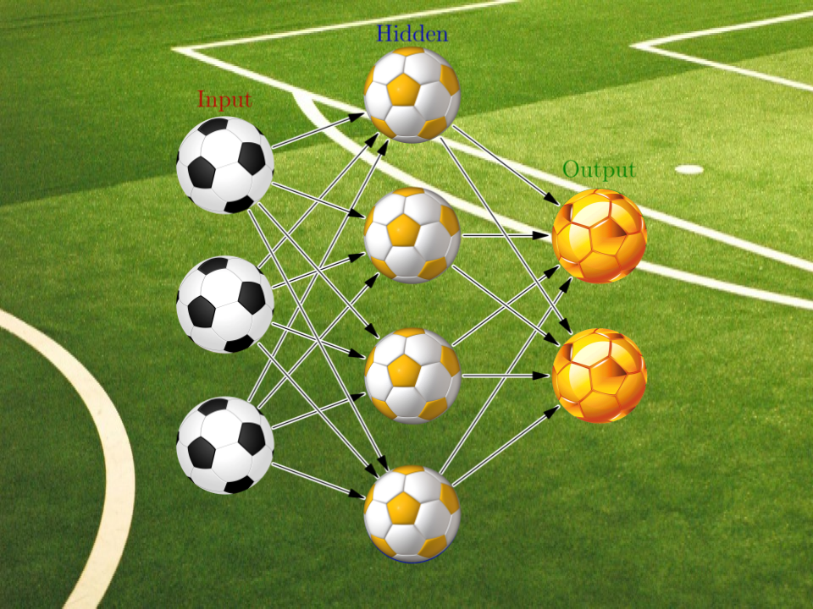
RANDOM FOREST
Why choose a Random Forest Classifier?
We knew our target values could be one of three options.
Random Forest models are robust to outliers, which can be frequent in sports.
We wanted to rank the importance of input variables in a natural way.

Slide 23
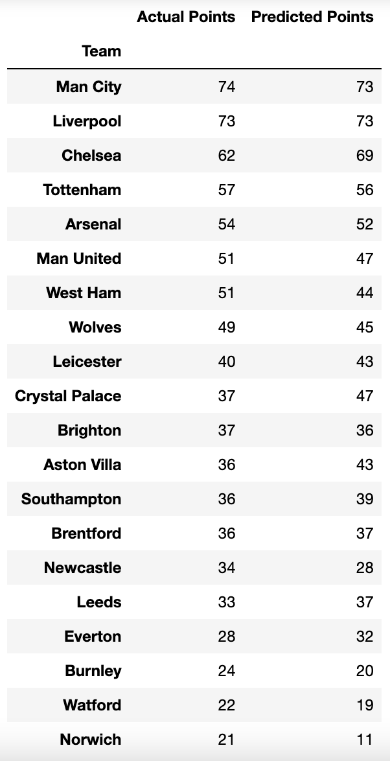
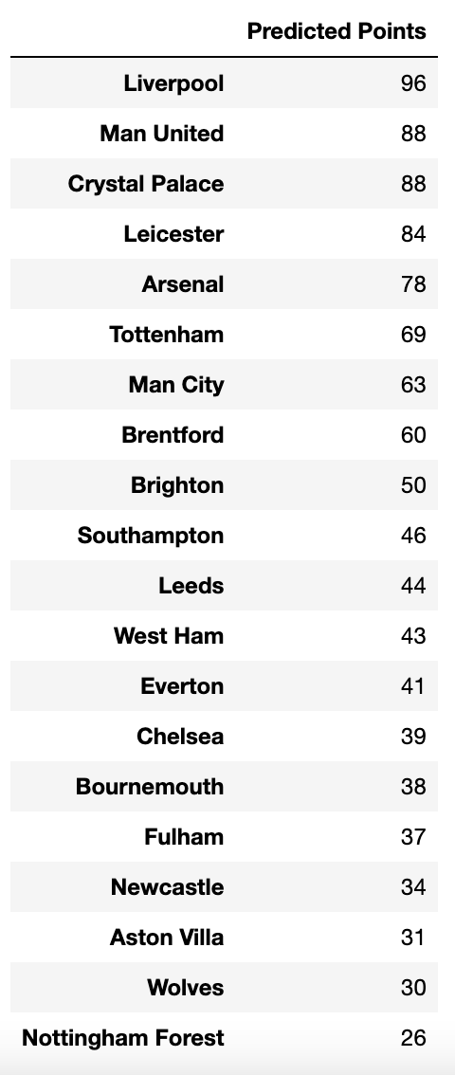
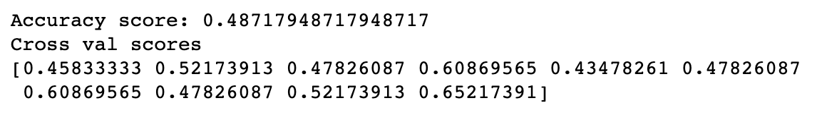
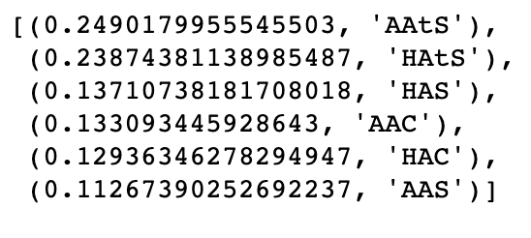
RESULTS FROM THE MODEL
Previous Season
Newest Season
Low accuracy score ☹
Attacking strength seemed to be the most important feature.

Slide 24

Taking a Closer Look
Summary
So much data!
The bottom three teams usually stay near the bottom, the top three teams usually stay near the top.
It really comes down to points and individual game events.
Ready to take the model to the bookie?
What exactly do red cards do?
Is every player a homebody or does it even matter?
Do the games come down an individual player and how they feel?

Slide 25

Challenges
Relegated and Promoted teams.
So much data!
Sum of parts greater than the whole.

Slide 26


THANK YOU
Trevor, Edwin, Kwasi, Sam, and Parker

